Slide 1
Science Logic
Windows Server PP
Dynamic Apps
Raul Diez Canseco Christian Galarza

Slide 2
Overview
Architecture
Installation
Upgrade
Windows Server Power Pack
Dynamics Aplications

Slide 3
overview

Slide 4
Architecture
All in One
Distributed
User Interface
Database
Data Collection
Message Collection
API

Slide 5
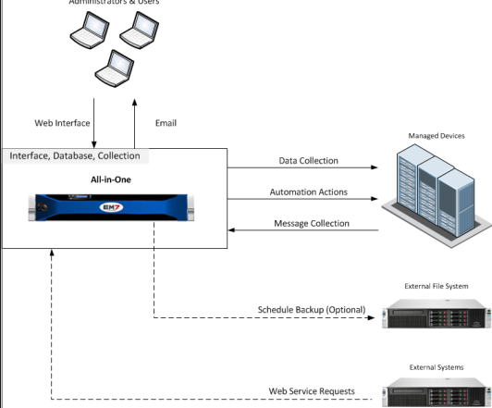
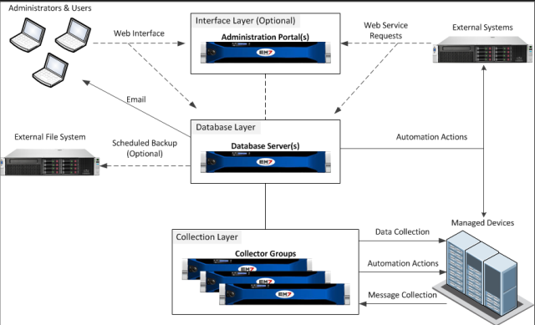
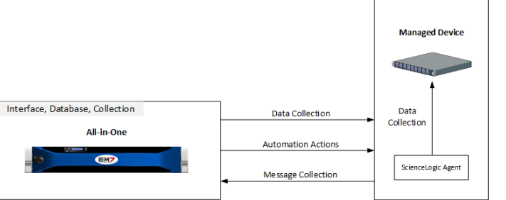
Architecture
All in One
Distributed
Agent

Slide 6
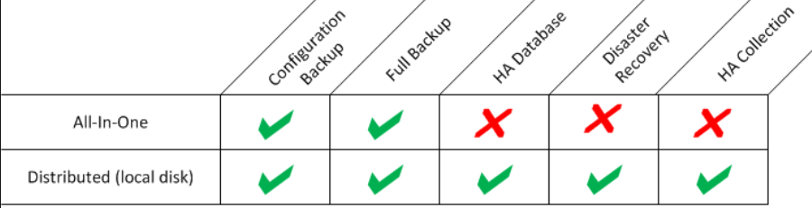
Backup, Recovery & High Availability Options
Configuration Backups
Full Backup
High Availability for Database
Disaster Recovery
High Availability for Data Collection

Slide 7
Installation
Hardware Requirements
Military Unique Deployment
More restricted use of credentials
 | RAM (GB) | CPU Cares | Disk (GB)
Database Servers | 6 | 2 | 80
Data Collectors | 4 | 2 | 60
Message Collectors | 6 | 2 | 60

Slide 8
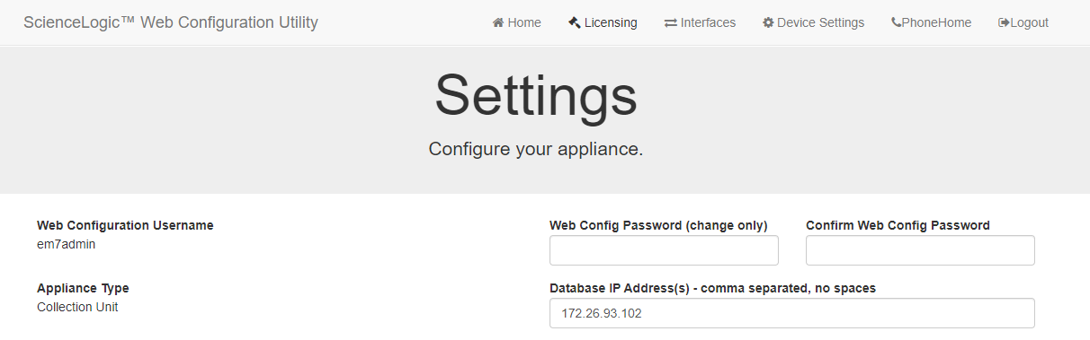
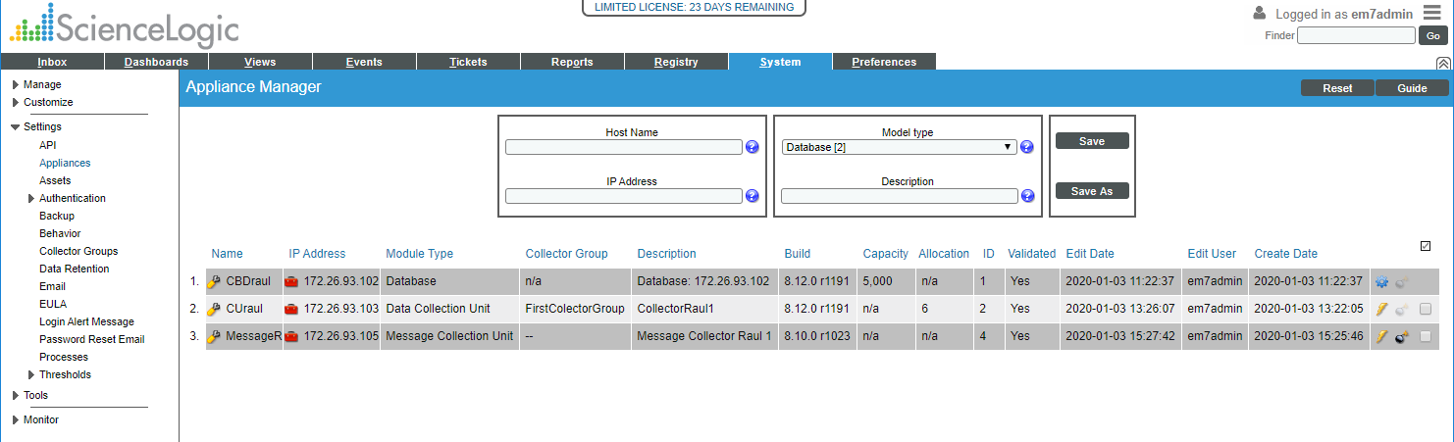
Configuration
Configure Distributed system
https://ip-address-of-appliance:7700
In SL1

Slide 9
Upgrade

Slide 10
Windows Server Power Pack

Slide 11
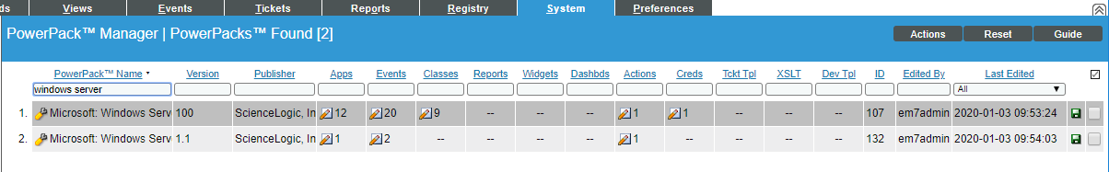
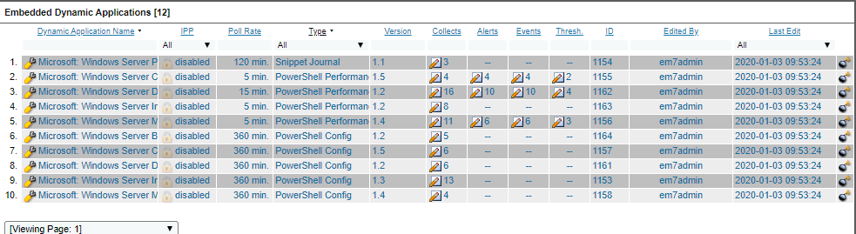
Windows Server Power Pack
Windows Server PowerPack

Slide 12
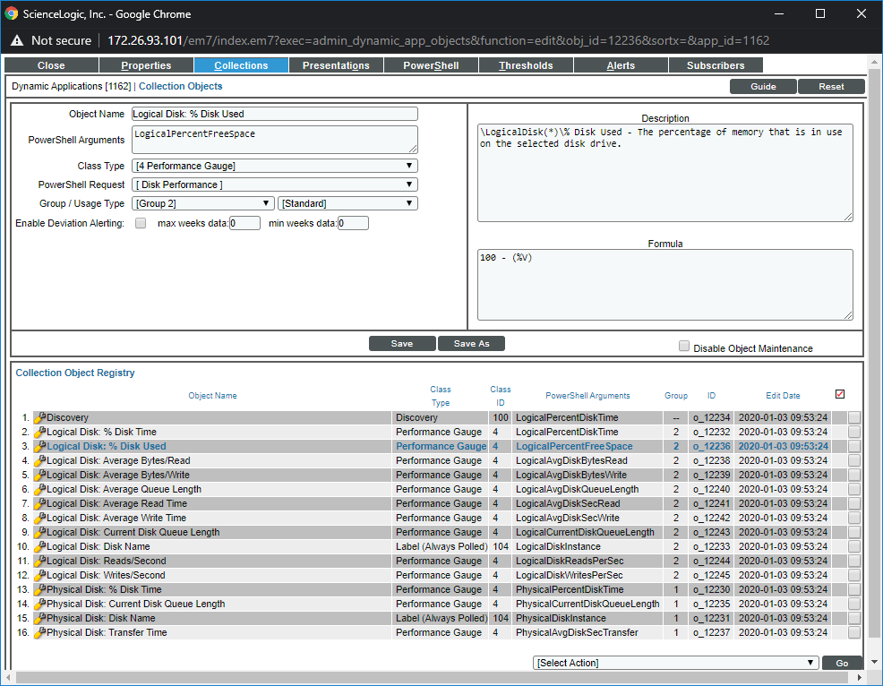
Collection objects

Slide 13
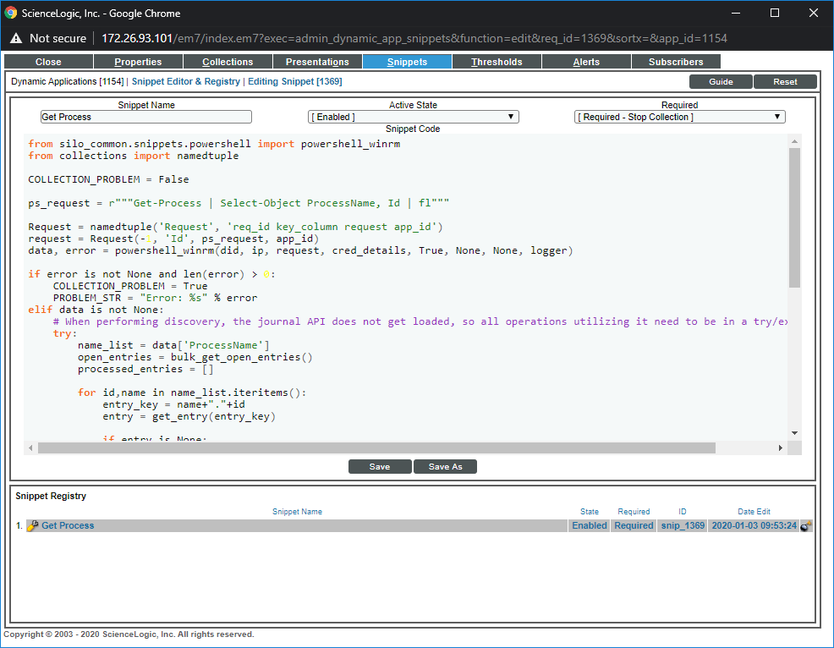
Snippels

Slide 14
Dynamics Applications
Archetypes
Performance
Configuration
Journal
Protocols
Bulk Snippet
Database
Internal Collection
PowerShell
Snippet
SNMP
SOAP
WMI
XML
XSLT

Slide 15
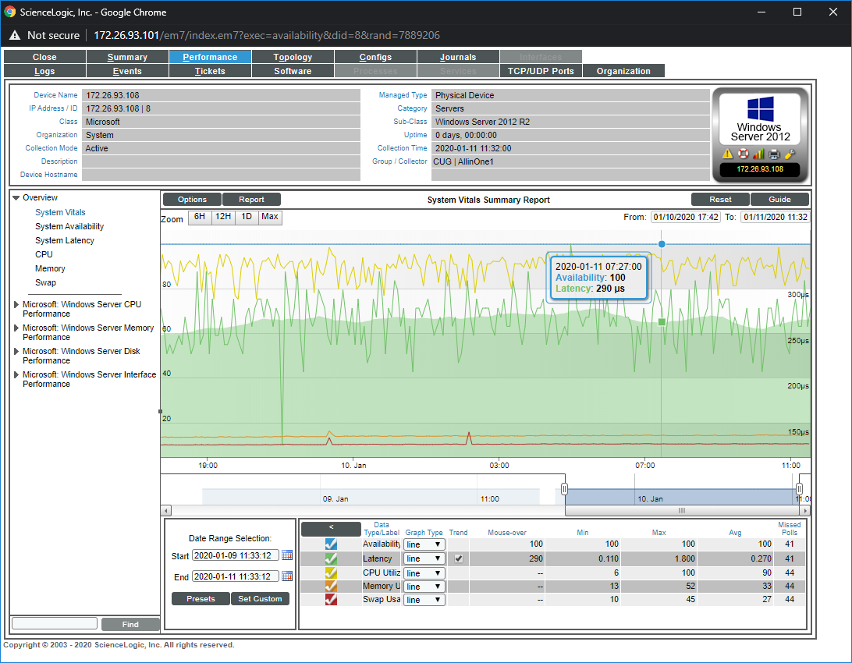
Dynamics Applications

Slide 16
